Slide 1
Extract, Transform, Load
Movielens Latest Datasets

Slide 2
Introduction
Dataset utilized: MovieLens Latest Datasets
Source: grouplens.org
Description: Dataset provides ratings from over 600 users corresponding to a sample of 9,000 movies. Additional information includes keyword tags, genre categorization, and the release year associated with each movie title.
Files under consideration:
movies.csv
ratings.csv
tags.csv
links.csv

Slide 3
Relevant Queries
Movies database querying:
How many movies were released in a specified timeframe (e.g.2019)? [PostgreSQL]
How are movies classified among genres? [Pandas]
Being able to get results of specified criteria (e.g. movie titles) [PostgreSQL]
What are the most frequently occurring genres (barchart)? [Pandas]
What is the distribution of movies by rating (pie)? [Pandas]

Slide 4
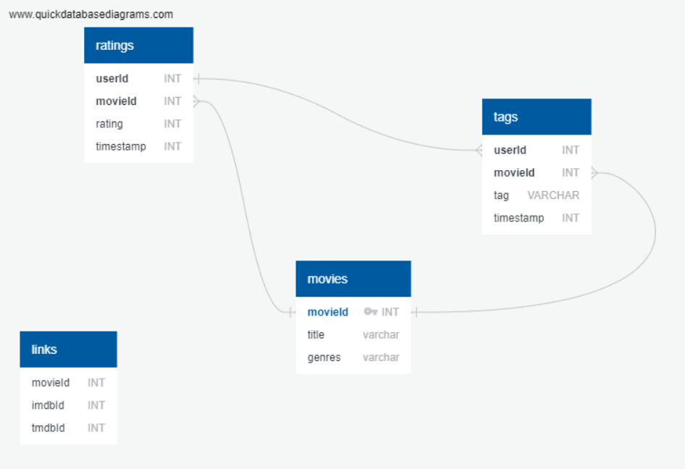
Entity Relationship Diagram (ERD)

Slide 5
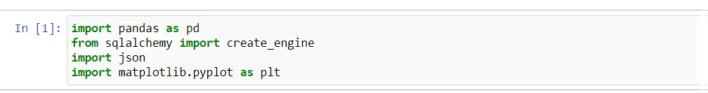
Dependencies in Pandas

Slide 6
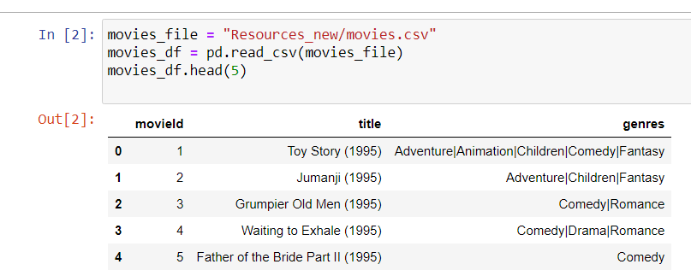
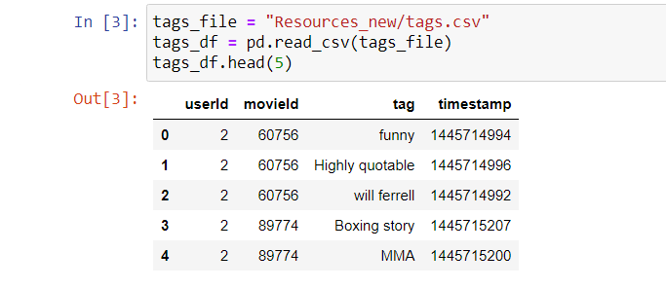
Import csv files into DataFrame: movies csv & tags csv

Slide 7
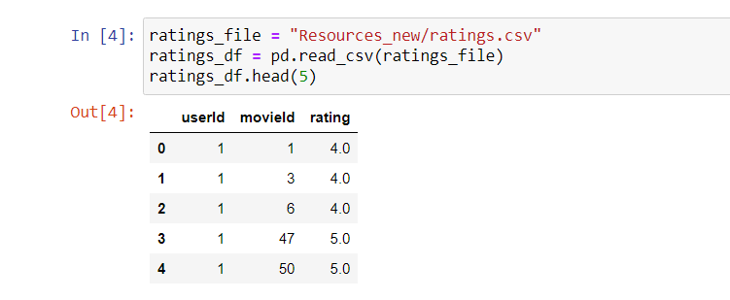
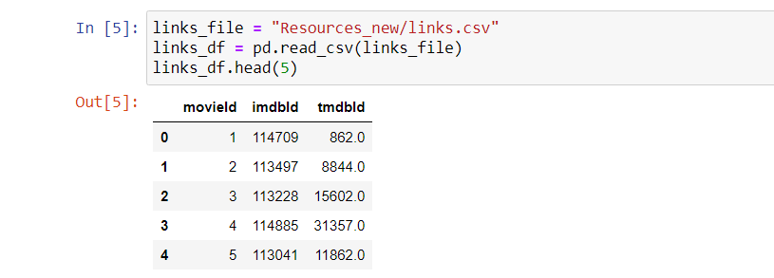
Import csv files into DataFrame: ratings csv & links csv

Slide 8
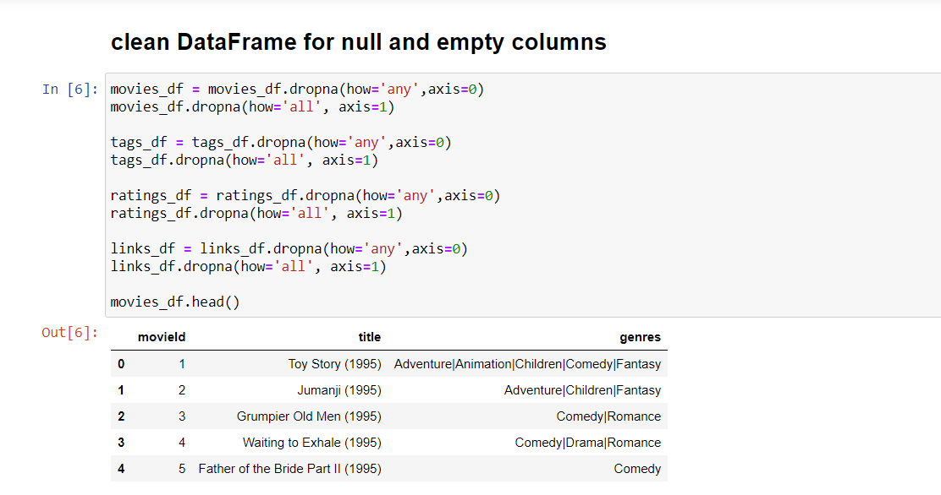
Clean DataFrame for null & empty columns

Slide 9
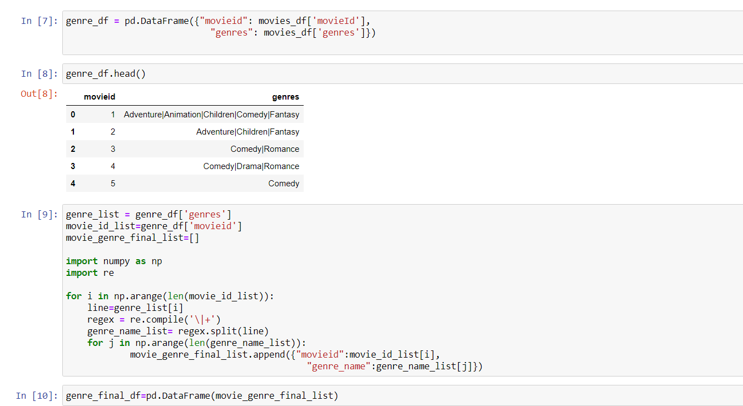
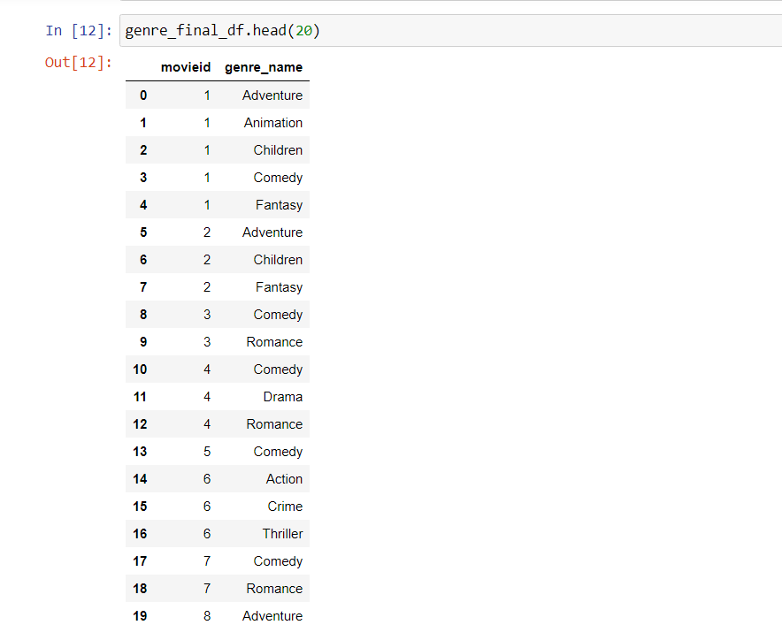
Create a new DataFrame for genre

Slide 10
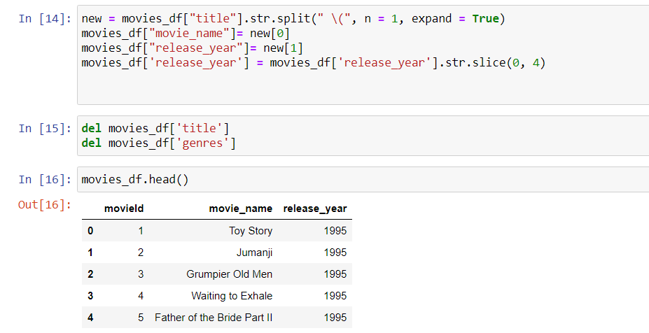
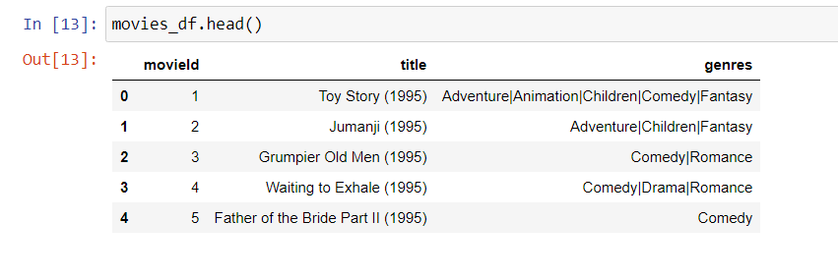
Clean Movies DataFrame

Slide 11
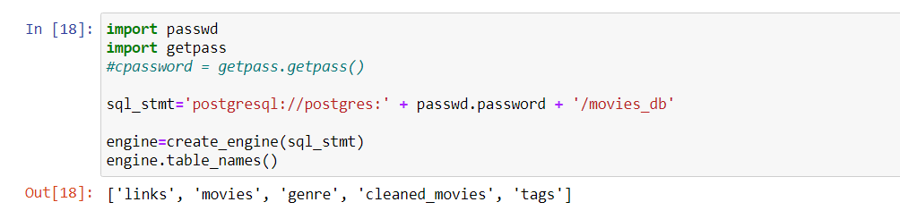
Convert Data Dictionary into DataFrame

Slide 12
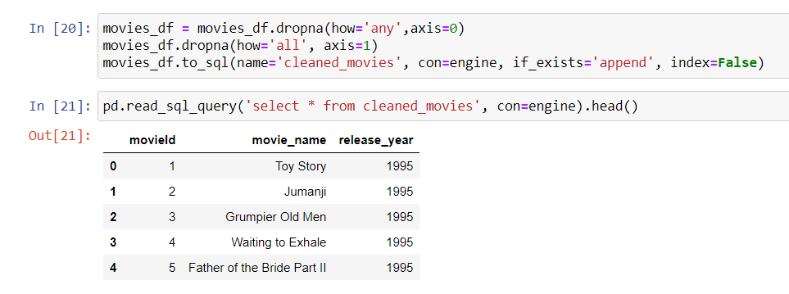
Select * From cleaned_movies

Slide 13
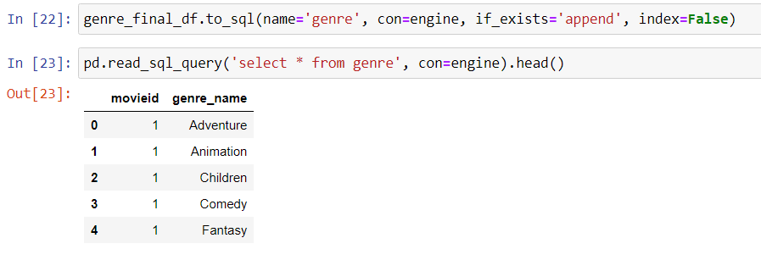
Select * From genre

Slide 14
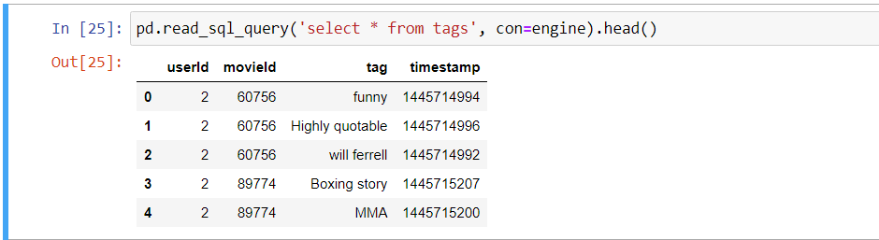
Select * From tags

Slide 15
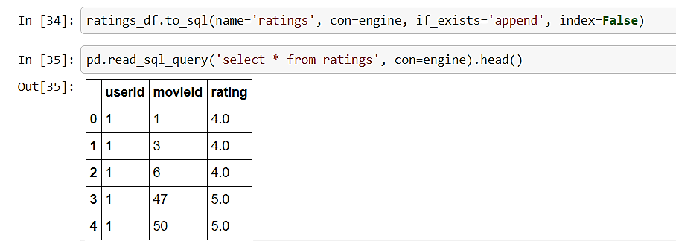
Select * From ratings

Slide 16
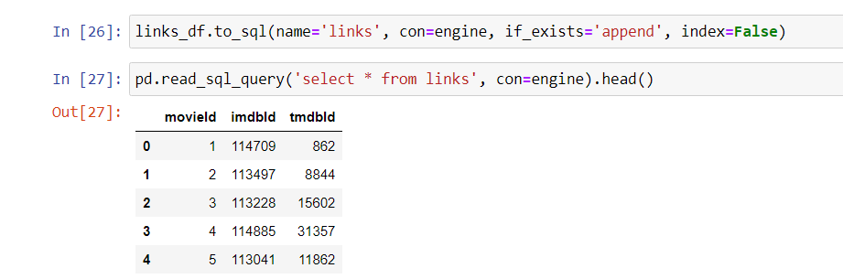
Select * From links

Slide 17
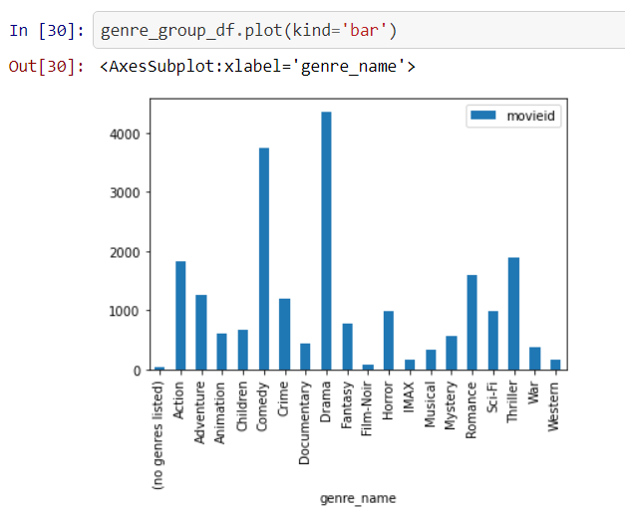
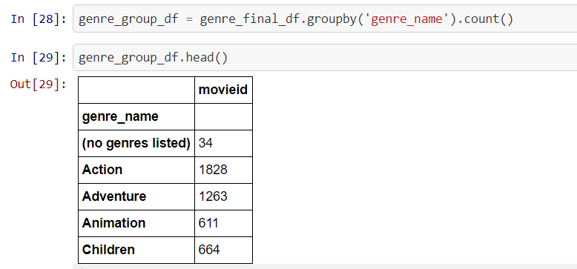
Total Movies By Genre Category

